Slide 1
Metadata needs
Carlo Torniai, Matthew Brush, Melissa Haendel

Slide 2
Outline
Issues about annotation standards and best practices
Needs
Additional application specific metadata
Additional metadata for Devs / Users
Better internal ontology documentation
Discussion

Slide 3
Issues
Redundancy
Inconsistency
Incompleteness

Slide 4
Issues: Redundancy <-> Inconsistency
rdfs:comments
IAO:editor note
IAO:curator note

Slide 5
Issues: Redundancy <-> Inconsistency
IAO:editor note
Def: A note containing points under consideration for further term development that may be included in released versions of the ontology. It should contain nothing embarrassing and something potentially useful for end users to understand the ontology. Editor notes should include the date of edit (YYYY/MM/DD) and the author.
IAO:curator note
Def:An administrative note intended for the curator of the ontology. It will not be included in the released versions of the ontology, so it should contain nothing necessary for end users to understand the ontology. Curator notes should include the date of edit (YYYY/MM/DD) and the author.
rdfs_comments: (no definition)

Slide 6
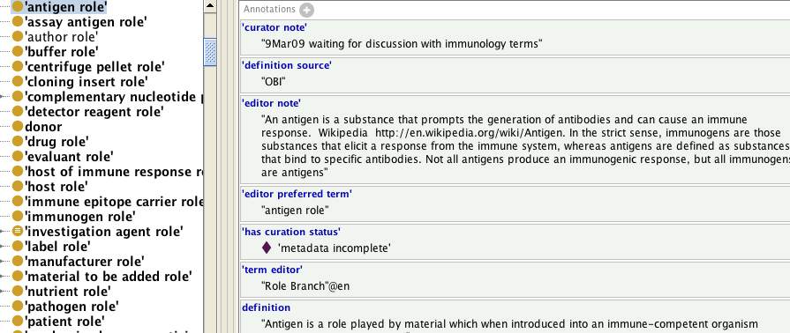
Examples

Slide 7
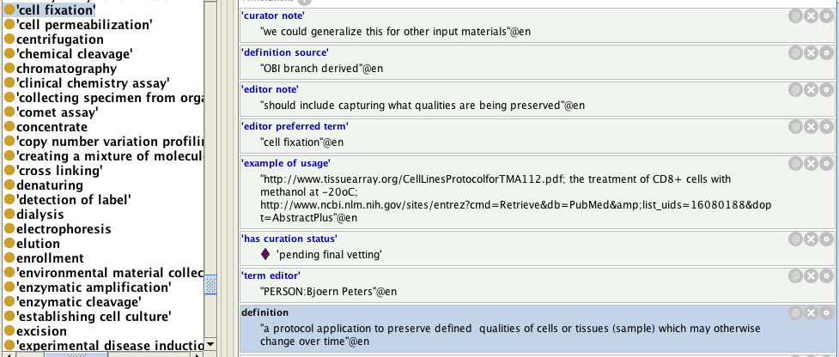
Examples

Slide 8
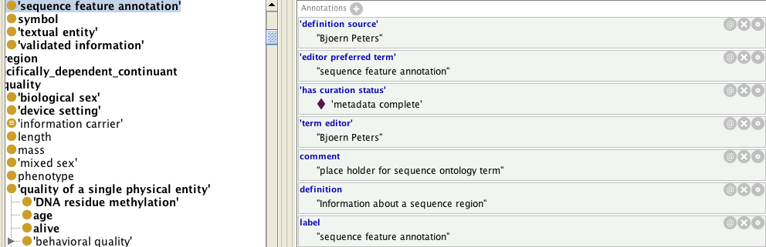
Examples

Slide 9
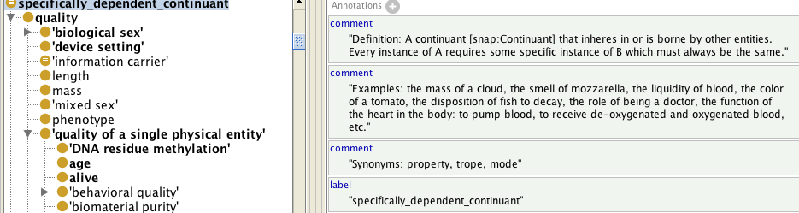
Examples

Slide 10
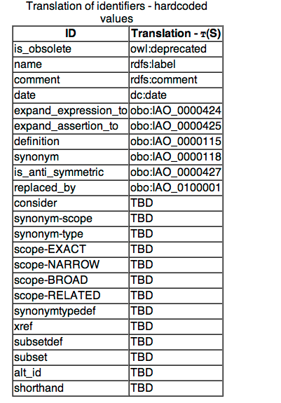
Issues: Incompleteness
OBO annotation translations
Currently not all OBO annotation properties are translated to OWL. If we want everyone to use IAO, these need to be mapped/added.
http://berkeleybop.org/~cjm/obo2owl/obo-syntax.html#5

Slide 11
Issues: Incompleteness
Shared application specific metadata
(currently, everyone invents their own)
Design choices documentation embedded in ontologies
Would like to add additional metadata for both end users and ontology developers

Slide 12
What should we do better
Lead by example about using annotations:
Avoid inconsistency
Provide clearer guidelines on usage of annotation properties
Contribute and extend annotations according to user needs

Slide 13
Application Specific Metadata
Some common needs, (see eagle-i ICBO paper) are the following:
application-specific labels
application-specific descriptions
ways to annotate classes to be excluded from the model used by the application
ways to set display ordering and grouping of properties

Slide 14
Application Specific Annotations
‘application-specific label’ (or ‘user interface label’)\
Definition: “The name of a class or a property that will be displayed, within an application.”
‘application-specific description’ (or ‘user interface description’)
Definition: “The description of a class or a property to be displayed to the end users of an application as tooltip or help. It conveys an explanation of the class or property usage within the application.”
‘application-specific restriction’
Definition: “A property to tag classes and properties with values that will inform the application specific behavior of the class or property. The values of application specific restriction come from a list of predefined terms, instances of the class application specific restriction specification.”

Slide 15
Implementation
Defined the following classes
“application-specific restriction specification”
Definition: “The application specific tag of a class or property within an application. The allowed values come from an enumerated list of predefined terms. See the specification of these instances for more detailed definitions of each enumerated value.”
Defined the following individuals:
‘to be excluded’ member of ‘application-specific restriction specification’

Slide 16

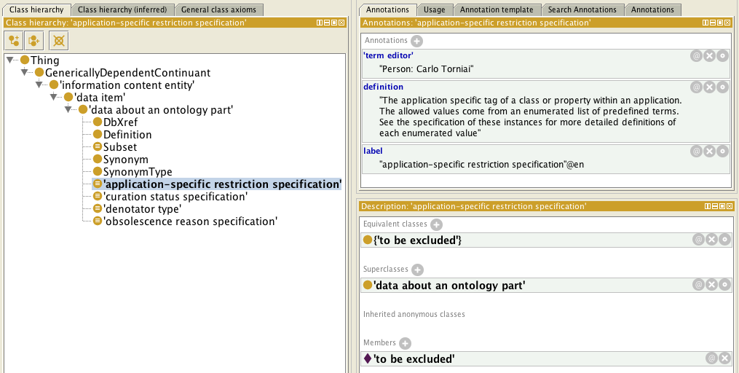
Implementation

Slide 17
Additional metadata for Devs / users
Stakeholders in ontology development include those performing:
‘Primary’ ontology development
building new terms and design patterns
‘Secondary’ ontology development
re-using classes from external ontologies in their modeling efforts
Ontology consumption
end users applying ontology terms to curate/annotate data, incorporate into a database model, etc
Consider types of annotations that would be useful for each class of stakeholder

Slide 18
Additional metadata for Devs / users
All Stakeholders:
Standard and consistent use of current available annotations
Standard way to communicate dev choices and design patterns within the ontology (ie internal documentation)
Primary Development (crafting new terms and design patterns)
Record history/evolution of a class (prior decisions, discussions)
Record specific types of developer ‘action items’
e.g. alternate modeling approaches not used, modeling issues to follow up on, ‘placeholder’ status, etc
‘editor note’ and ‘curation status’ currently used for all such issues, but not in the most consistent and efficient way
Notes:
need to have an "end-user" definitionversion, or obo foundry definition- basically the human readable def that can be read in any context.
what is point of editor preferred term? is the same as obo foundry unique label, there is the label property. The development of these two things should parallel each others.

Slide 19
Additional metadata for Devs / users
Secondary Development (re-using terms form external ontologies)
Explain high level concepts and principles behind ontology structure and design to facilitate proper re-use
Need to accommodate ‘alternate’ definitions when MIREOTing terms
Record and track issues for feedback to external source ontologies
Consumption by end users (annotators/curators)
annotations describing terms and their intended use in user-friendly manner (particularly for ontologies driving applications)
Notes:
need to have an "end-user" definitionversion, or obo foundry definition- basically the human readable def that can be read in any context.
what is point of editor preferred term? is the same as obo foundry unique label, there is the label property. The development of these two things should parallel each others.

Slide 20
Additional metadata for devs and users: Proposals
“Alternative description”
This is meant to be used to parallel editor preferred label
Particularly useful for slims or applications where there is a need to have a context independent definition in simple human readable form.
Could be useful simply for converting imported term definition into aristotelian form that is consistent with importing ontology (ie changing genus and references to ontology terms in the differentia) . . .
. . . or to extend or enhance the imported term definition to make distinctions important in the context of the importing ontology (where the new definition does not change the original meaning, of course)

Slide 21
Examples of editor-preferred definitions in ReO
Simple changes of genus :
Example 1 : SO:gene
SO def - a region (or regions) that includes all of the sequence elements necessary to encode a functional transcript. . . .
ReO def - a genetic locus that includes all of the sequence elements necessary to encode a functional transcript . . .
Example 2 : OBI:assay
OBI def - a planned process with the objective to produce information about some evaluant
ReO def - a technique with the objective to produce information about some evaluant

Slide 22
Examples of editor-preferred definitions in ReO
Extension/Clarification/Contextualization of Meaning:
Example 1 : OBI:material processing technique
OBI def - A planned process which results in physical changes in a specified input material
ReO def - a planned process which results in specified reorganization or structural changes to some input material. This includes processes such as material component separation and combination, as well as changes that alter the internal arrangement of an input material at a molecular or macroscopic level.
Example 2 : OBI:evaluant role
OBI def - a role that inheres in an entity that is realized in an assay in which data is generated about the bearer of the evaluant role
ReO def - a role that inheres in an entity that is gained through a planning process upon an agent’s intent to study the entity in some assay, and realized in the execution of an assay which generates data about the entity

Slide 23
Discussion
There is some overlap between application specific metadata and Dev/ End User metadata (application specific description / end user definition)
Pro and cons
How to combine/harmonize application specific metadata with community views implementation?
OWL annotations on top of other stuff?
Notes:
This idea can be paired with the approach (which now we follow also in OBI) for having each application-specific annotation in a separate file (see latest OBI dev list mails on the topic).I haven’t addressed here other issues/possibilities. For instance if we think that it would be useful to combine and display different application-specific annotation within Protégé it would be great to know which annotation belongs to which application and we could use axioms annotations for that. Another interesting issue from an application point of view, is the need to have semantically equivalent properties with different subsets of domain and range. This can be addressed in several ways (form having just sub properties or, as we are handling it now in eagle-i, defining additional annotation properties tht restrict the domain and range of a property when required).ANyway I just wanted to start a discussion and understand what are your thoughts. I think that it's worth to try to address these needs and formalize a proper representation even if IAO may not be the proper place to implement them.It would be great if we could even briefly chat about this topic sometimes soon. Let me know.

Slide 24
Decisions
AIs: Write a white paper, starting from these slides that summarize the needs and flash out proposals
(Start form this paper: http://www.ncbi.nlm.nih.gov/pmc/articles/PMC2684543/)
Ideas/decisions:
1) for the 'application specific label' have a subclass of alternative term creating an application specific label such as: "eagle-i alternative term" "ReO alternative term"
2) There is going to be the "alternative description" is going to be a new IAO property.
Then we can have subclasses under this like "ReO alternative description" "IEDB alternative description" as for the application specific label
3) For the application specific restriction
- use “insubset” with a set of standard instance value (created in IAO)
4) It would be nice to have tracker items linked to terms
- For this purpose we should use the 'require discussion' instance value under the curation status specification
5) Rename curator note in "internal note" this property can be used ot keep track of tracker items as well

